Slide 2
Introduction
High-dose chemotherapy followed by autologous stem cell transplantation (ASCT) – a mainstay of treatment for newly diagnosed, eligible patients with MM
Collection of enough amounts of CD34+ hematopoietic stem cells (HSC) – important for successful engraftment and avoidance of transplant-related complications
Most commonly used approaches to stem cell collection – G-CSF alone and CY mobilization
Adequate number of HSC – remains a challenging issue in the ASCT for patients with MM, because it could be influenced by tumor burden, previous treatment (esp., lenalidomide), and patients’ age
Febrile neutropenia – most common cause of mortality in a substantial proportion of patients with MM, who received CY mobilization

Slide 3
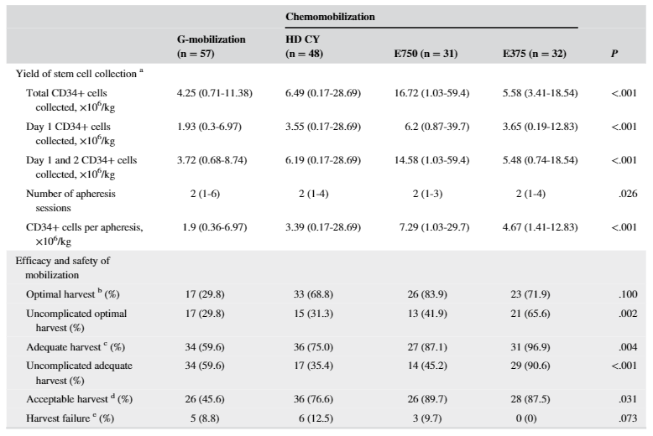
Single-dose etoposide mobilization in autologous SC mobilization for MM patients
Comparison of mobilization outcomes of G-CSF, HD CY (3.5 g/m²), and intermediate-dose (E375; 375 mg/m² for 1 day) and single-dose(E750; 375 mg/m² for 2 days) etoposide
J Clin Apher. 2019 Oct;34(5):579-588.

Slide 4
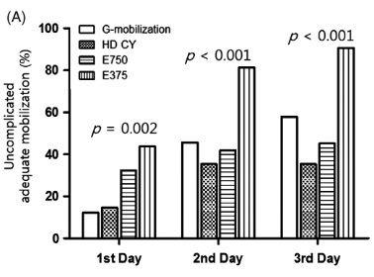
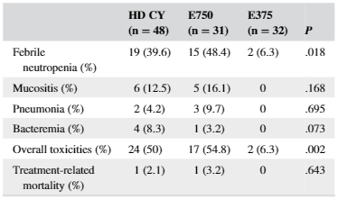
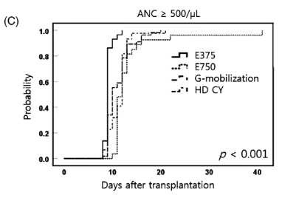
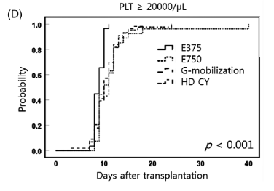
Single-dose etoposide mobilization in autologous SC mobilization for MM patients
Comparison of grade 3–4 toxicities according to mobilization methods
Cumulative percentages of uncomplicated adequate harvest for each mobilization method according to each day of apheresis
Kaplan-Meier curve for neutrophil engraftment after ASCT
Kaplan-Meier curve for platelet engraftment after ASCT
J Clin Apher. 2019 Oct;34(5):579-588.

Slide 5
G-CSF + patient-adapted plerixafor vs CY mobilization in autologous SC mobilization
A retrospective study of 50 MA and 81 CY cohort patients
Mobilization completion rate of the MA and the CY cohorts – 98% (95% CI, 94.1 – 100) vs 77.8% (95% CI, 68.7 – 87.8) (P < 0.01)
Median yield of CD34 + cells of the MA and the CY cohorts – 7.0 × 10⁶/kg (IQR, 4.2 – 9.9) vs 7.7 × 10⁶/kg (IQR, 5.0 – 12.7) (P = 0.08)
Bone Marrow Transplant. 2011 Apr;46(4):523-8.

Slide 6
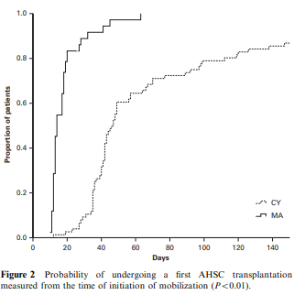
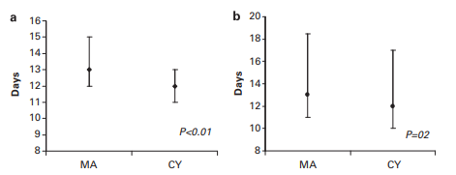
G-CSF + patient-adapted plerixafor vs CY mobilization in autologous SC mobilization
Hospitalization during mobilization of the MA and the CY cohorts –2.0% (95% CI, 0.0 – 5.9) vs 30.0% (95% CI, 19.7 – 39.6) (P < 0.01)
Neutropenic fever of the MA and the CY cohorts – 6.2% (95% CI, 0.9 – 11.4) vs 26.0% (95% CI, 16.4 – 35.5)
Cost of mobilization of the MA and the CY cohorts - US$ 23,893.28 vs US$ 29,423.31
Mobilization to transplantation time of the MA and the CY cohorts – 14 days (IQR, 12 – 18) vs 43 days (IQR, 36 – 67) (P < 0.01)
Neutrophil engraftment of the MA and the CY cohorts – 13 days vs 12 days (P < 0.01)
Platelet engraftment of the MA and the CY cohorts – 13 days vs 12 days (P < 0.20)
Bone Marrow Transplant. 2011 Apr;46(4):523-8.

Slide 7
Proposal
A phase III study of single-dose etoposide vs G-CSF + patient-adapted plerixafor in patients with MM

